Slide 1



Name Of The Project :
PLANT DISEASE DETECTION USING DL
JANGATI VISHNUPRIYA
AICTE Internship ID : INTERNSHIP_174099535967c57b1f336c3

Slide 2

Learning Objectives
Introduce Convolutional Neural Networks (CNNs):
CNNs are Deep Learning models designed for image based tasks like classifying healthy and diseased plant leaves.
Classification Process :
The CNN model analyzes leaf images through multiple layers to automatically extract features and classify them as healthy or diseased.
Deep learning classes include :
Healthy(no diseased), Diseased(visible symptoms like spots or blight and Other/Unknown(unclear or multiple conditions).
Metrics used : such as Accuracy, Precision, Recall.
Real world applications of the model like Smart Farming app
GOAL
Source :
https://github.com/Jangativishnupriya/Week-1.git

Slide 3
Tools and Technology used
Programming language : Python
– chosen for it’s simplicity and powerful libraries for deep learning.
Frameworks : TensorFlow and Keras
– used to build, train and evaluate the CNN model.
Development Environment : Google Colab
– leveraged for it’s cloud-based GPU support and easy collaboration.
Dataset : Kaggle
– dataset of healthy and diseased plant leaf images.
Image Processing Tool : OpenCV
– used for pre-processing tasks like resizing and augmentation.
Visualization Tools : Seaborn
– used to plot training metrics and confusion matrices

Slide 4
Methodology
Data Collection:
Dataset includes 38 different leaf disease classes.
Data Preprocessing:
Performed rescaling, normalization, and label encoding to prepare the data.
Model Selection: Used a 4-layer CNN with 4 Conv2D layers, Dense layers, EarlyStopping, Checkpointing, and Class Regularization (CR).
Model Training:
Trained the CNN model using the processed dataset.
Evaluation Metrics:
Evaluated using accuracy, loss, precision, recall.

Slide 5
Problem Statement:
In agriculture, early and accurate detection of plant diseases is crucial for maintaining crop health and ensuring high yield. However, traditional methods of disease identification rely heavily on manual inspection, which is time-consuming, labor-intensive, and highly dependent on the expertise of the observer.
This often leads to delayed diagnosis, inconsistent results, and ineffective disease management. Crops such as apple, cherry, grape, and corn are particularly vulnerable to a variety of diseases that, if not identified early, can significantly impact productivity and farmers' livelihoods.
There is a growing need for an automated, reliable, and scalable solution that can assist in rapid plant disease diagnosis to support sustainable agriculture.

Slide 6
Solution:
To address the challenges of manual plant disease identification, this project proposes a Convolutional Neural Network (CNN)-based Plant Disease Detection System. The model is trained to detect and classify plant diseases from leaf images of crops such as apple, cherry, grape, and corn. By automatically identifying whether a leaf is healthy or affected by a specific disease, the system enables early diagnosis, improves decision-making, and reduces reliance on expert intervention.
The model offers high accuracy and scalability, making it suitable for real-world agricultural use, where it can significantly enhance disease management and promote sustainable farming practices.

Slide 7
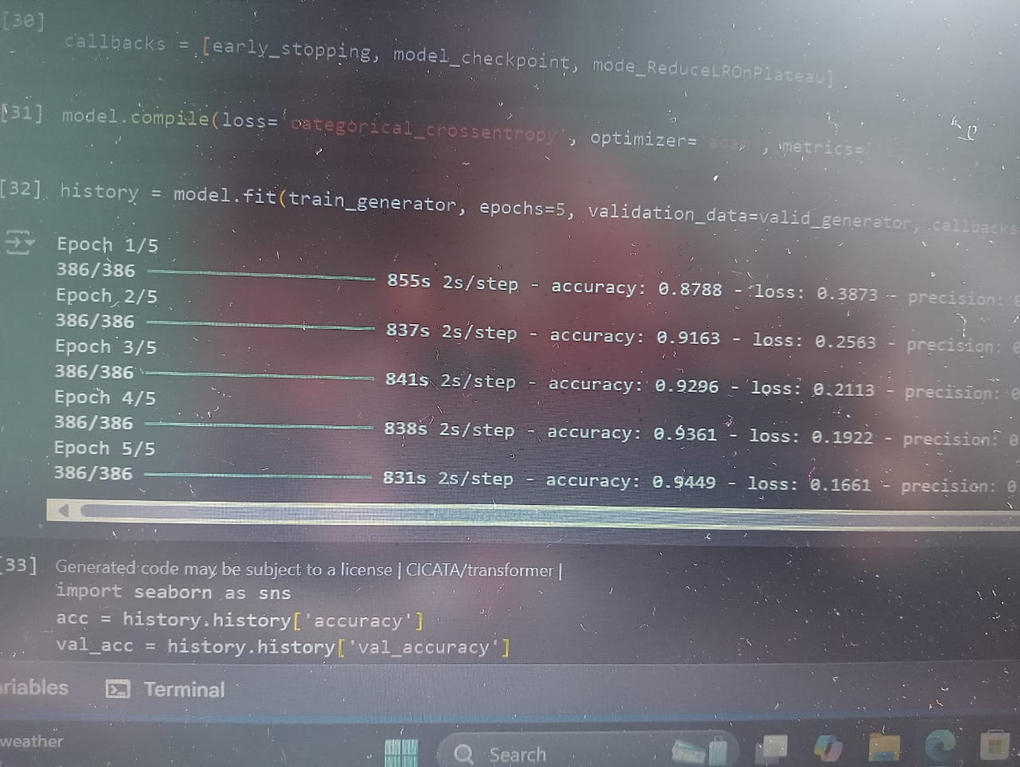
Screenshot of Output:

Slide 8
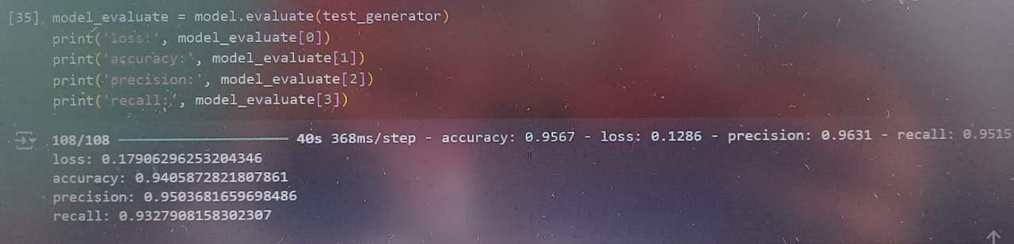
Screenshot of Output:

Slide 9
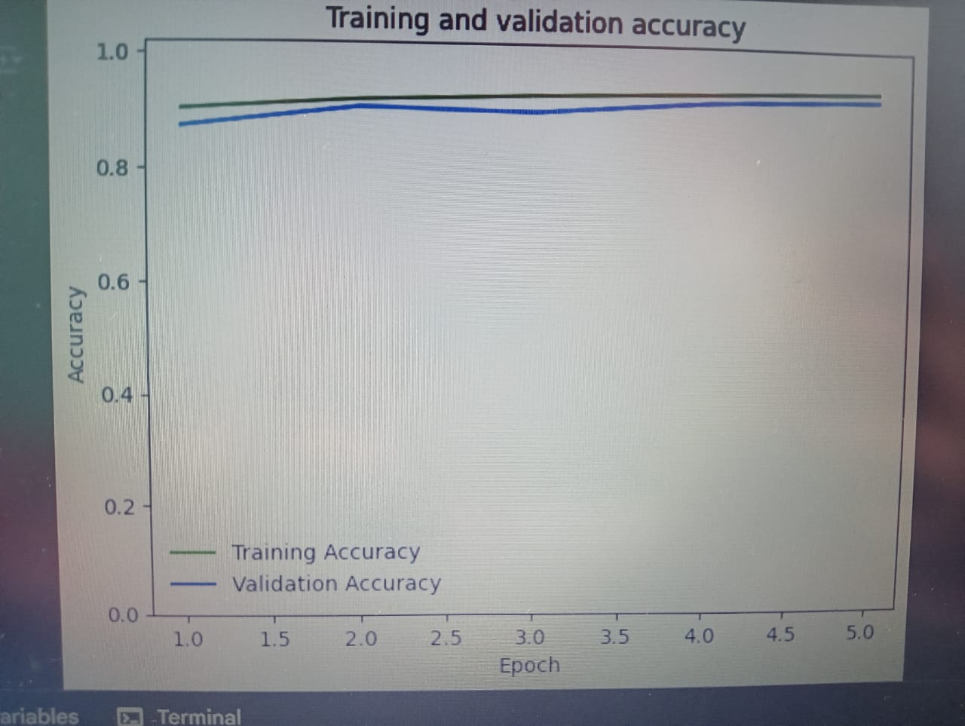
Screenshot of Output:

Slide 10
Conclusion:
The proposed CNN-based Plant Disease Detection System demonstrates the potential of deep learning in transforming traditional agricultural practices. By accurately classifying healthy and diseased leaves across crops like apple, cherry, grape, and corn, the system provides a reliable, fast, and scalable solution for early disease diagnosis.
This not only reduces dependency on manual inspection but also empowers farmers to take timely action, thereby minimizing crop loss and improving yield. With an accuracy of up to 94.1%, the model proves to be an effective step toward smarter, technology-driven, and sustainable agriculture. As AI continues to evolve, such solutions are set to play a crucial role in securing global food production.

